Slide 1
GIT Cheetsheet
Must know git commands

Slide 2
Create an account & Install GIT
To sign up for a free GitHub account, go to:
https://github.com
To install Git on your computer, go to:
https://github.com/git-guides/install-git and follow directions for your operating environment
Alternatively: https://git-scm.com/book/en/v2/Getting-Started-Installing-Git
Config settings
git config - - global user.name “your user name”
git config - - global user.email “your email address”
git config - - global user.password “password”

Slide 3
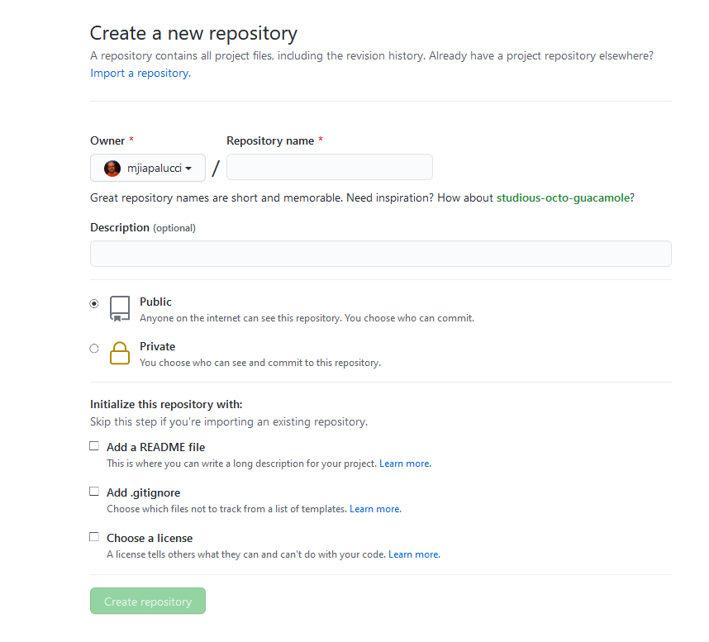
Create a new repository
https://github.com/new

Slide 4
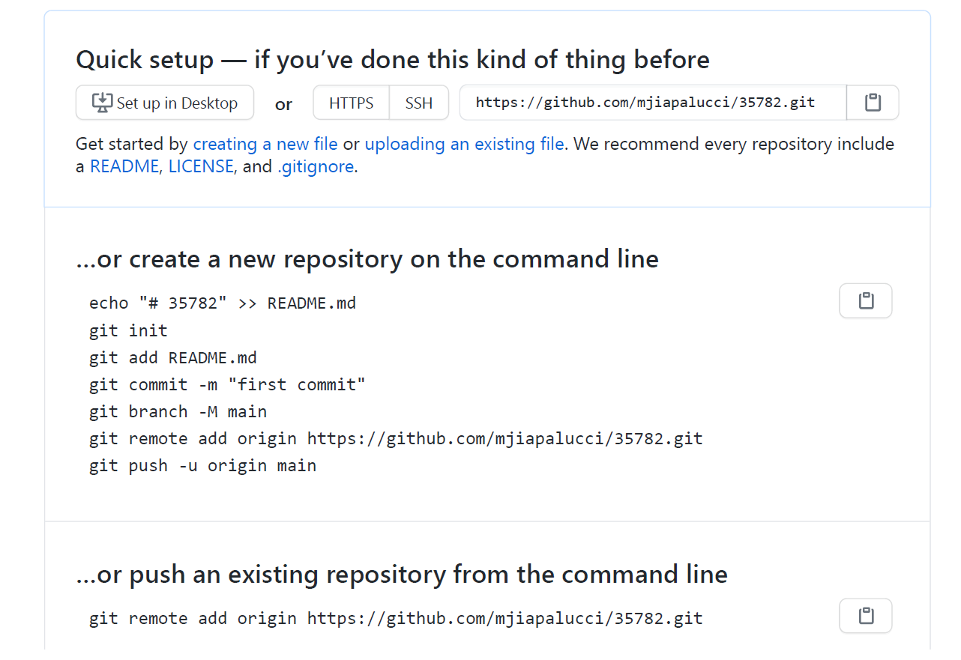
Follow the prompts on the next screen
Init from the command line
Or clone

Slide 5
Main Git commands
git status – to see where you are with your local repository
git add <file_name> - to add a file (or stage the file) to be added from your local repository to the main branch in the remote repository
git commit –m “text description of the commit”
git push – push all commits from the local repo to the remote repo
git clone <url of repository to clone> - copy a repository to your local machine
git pull <url of repository> pull all files from remote repo to local machine
Documentation - https://git-scm.com/doc

